Slide 1

MagBuy
E-COMMERCE by
Lachezar Gadzhev & Rangel Mihaylov
https://github.com/lgadzhev/MagBuy

Slide 2
About us
Lachezar Gadzhev
From Velingrad
Graduated English High School “Vasil Levski “
Participated in the creation of IN TOUR BG– best student company at Accenture in Oslo 2011
Law student at Sofia University "St. Kliment Ohridski“
Student Council at Sofia University "St. Kliment Ohridski“
Worked for Dimitrov, Petrov & Co
Hobbies: guitars, karaoke, camping etc.
https://github.com/lgadzhev/MagBuy

Slide 3
About us
Rangel Mihaylov
From Plovdiv
9 years experience as professional DJ
Graduated French High School “Antoine de Saint-Exupéry” in Plovdiv
Psychology student at Plovdiv University
Certified in PHP MVC Frameworks (2017)
Audio editor and content creator
Loves to travel
https://github.com/lgadzhev/MagBuy

Slide 4
What is MagBuy?
Final Project for IT TALENTS
Independent Online Shop
Solution for merchants
Collaboration between two full stack web developers
Hours of hard work and sleepless nights…
https://github.com/lgadzhev/MagBuy

Slide 5
How we realized MagBuy
MySQL Database
Back-end by PHP
Front-end by HTML, CSS and JS
VCS - Git
Libraries: Bootstrap, JQuery, Font Awesome
Others: FlexSlider, ImageZoom, Infinity Scroll W3 Slider, Google Fonts, Composer, PHP Mailer, Xampp, htaccess
https://github.com/lgadzhev/MagBuy

Slide 6
How we realized MagBuy
Design patterns
Front and Back-end division
Model View Controller (MVC)
Data Access Objects (DAO)
Object Oriented Programming (OOP)
Folders categorized by namespaces
Singletons, autoloader
https://github.com/lgadzhev/MagBuy

Slide 7
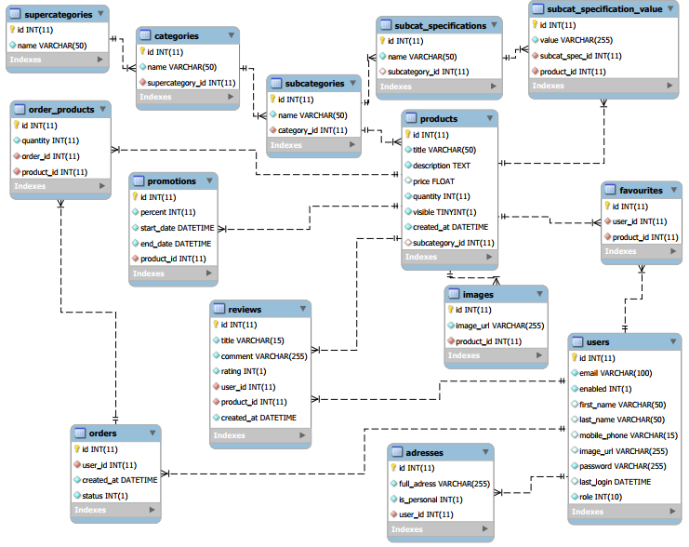

Slide 8
MagBuy
THANK YOU FOR THE CHANCE!
https://github.com/lgadzhev/MagBuy

